Slide 1
Final Presentation
Group 1

Slide 2
Introduction
Classifying Emotions: To categorize the facial expressions into 7 classes by learning from relative images.
Approach: A normal CNN architecture
Algorithms: Data generator, early stopping, confusion matrix, etc.

Slide 3






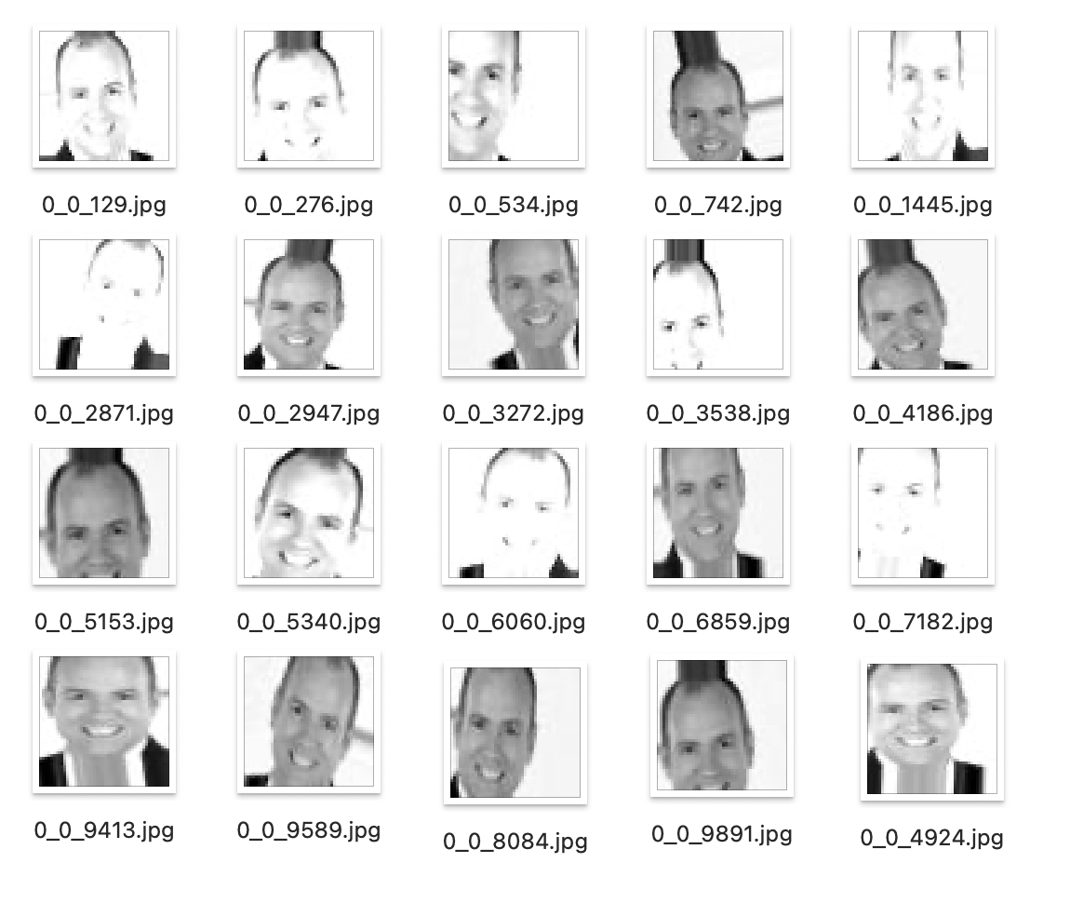







Methodology
3 classes
meaningless
cartoon
realistic
Dataset processing
Step1.
Delete all the meaningless pictures in data.
Step2.
Using ImageDataGenerator to generate 20 similler pictures from one orignial date to augmentate
meanless picture in train/surprise
19197283
48403842
57669898
meanless picture in train/happy
9150638
7944128
30373500
original picture
meanless picture in test/surprise
57669898
57200649
53795000

Slide 4
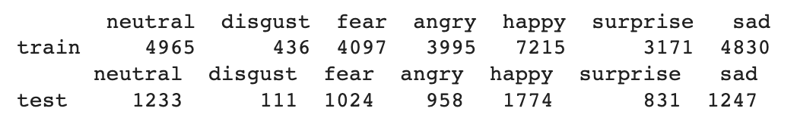
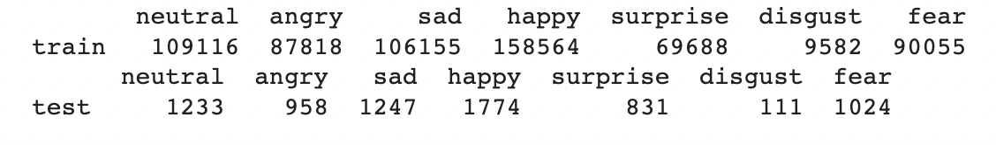
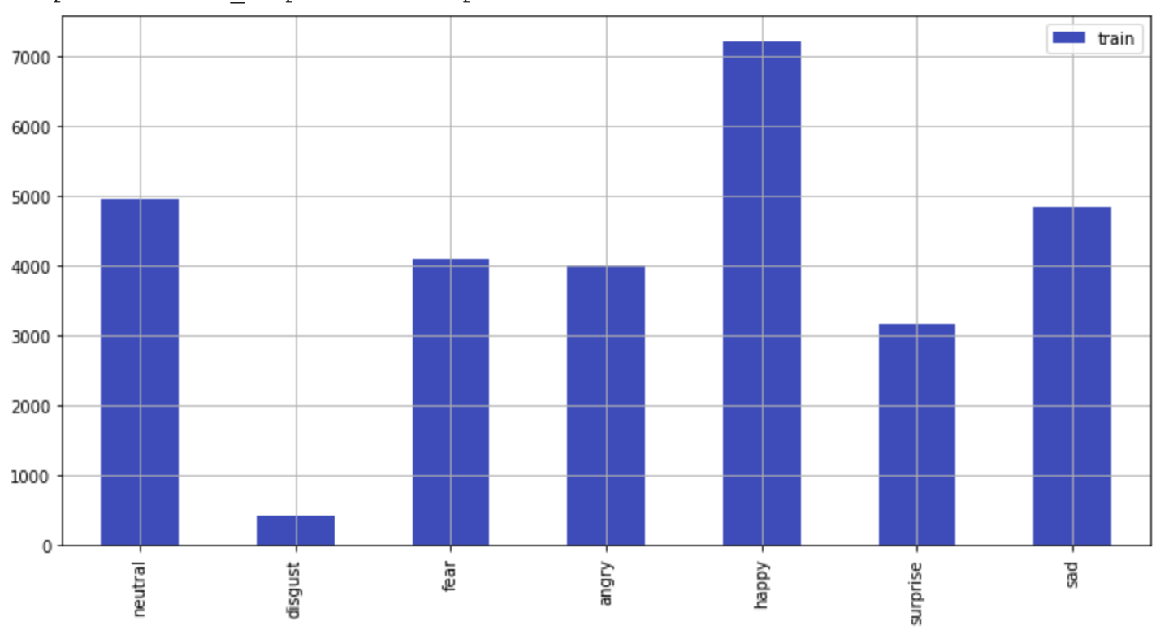
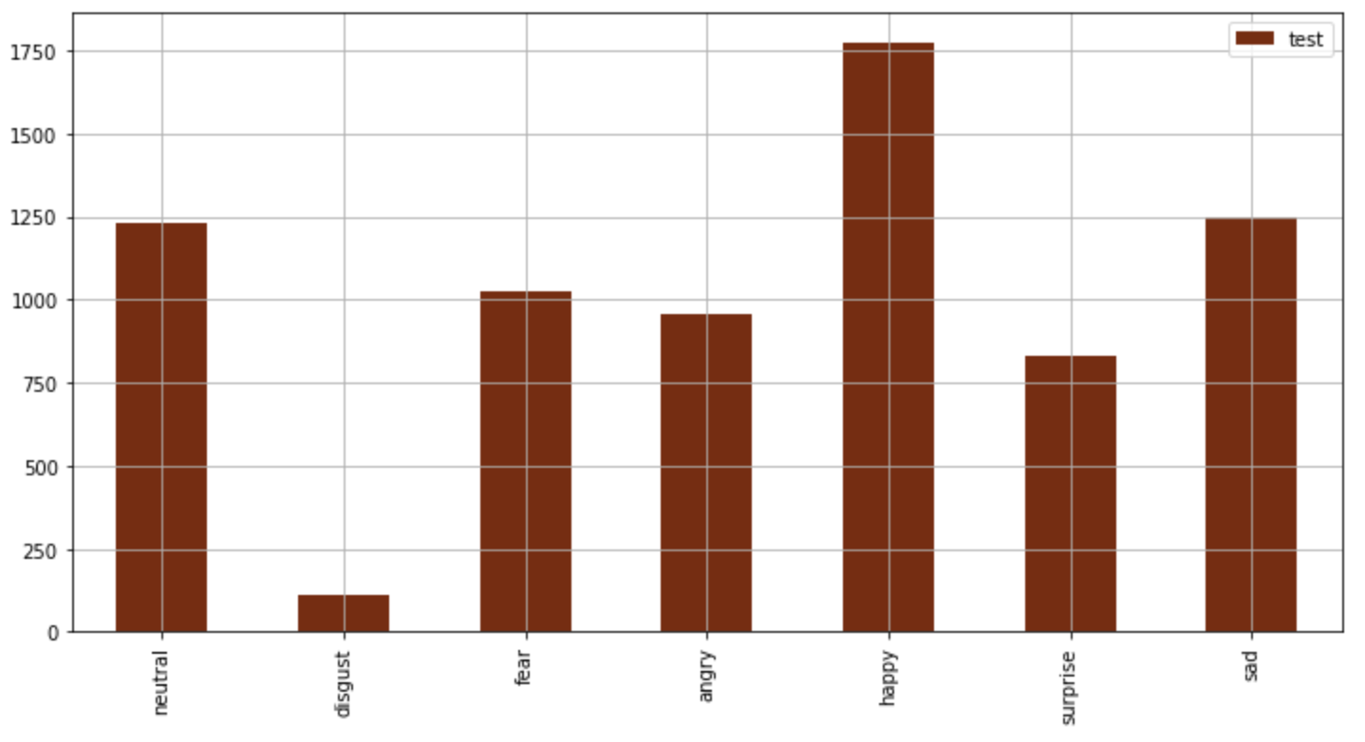
Methodology
Data distribution table:
Dataset processing
Step3.
Check the training & test data distribution of 7 classes of emotions
Augmentated Data distribution table:
Training data distribution bar chart:
Testing data distribution bar chart:
After augmentation, the accuracy increase 5%

Slide 5
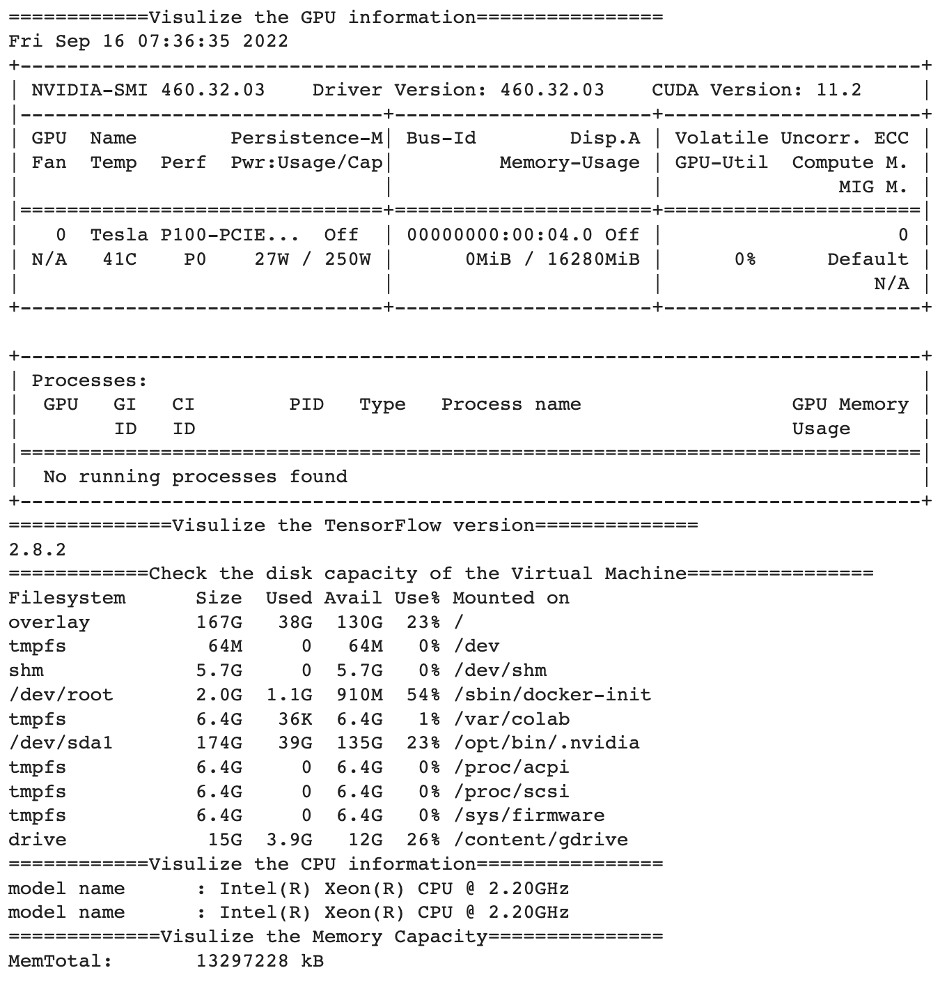
Methodology
Code Description
Packages:
For constructing the network and training: Keras and its sub-packages (models, layers, preprocessing, optimizers, callbacks, regularizers)
For processing and ploting data: Pandas, Numpy, Matplotlib, pathlib, tf_keras_vis(saliency, gradcam, utils…).
Some other information

Slide 6
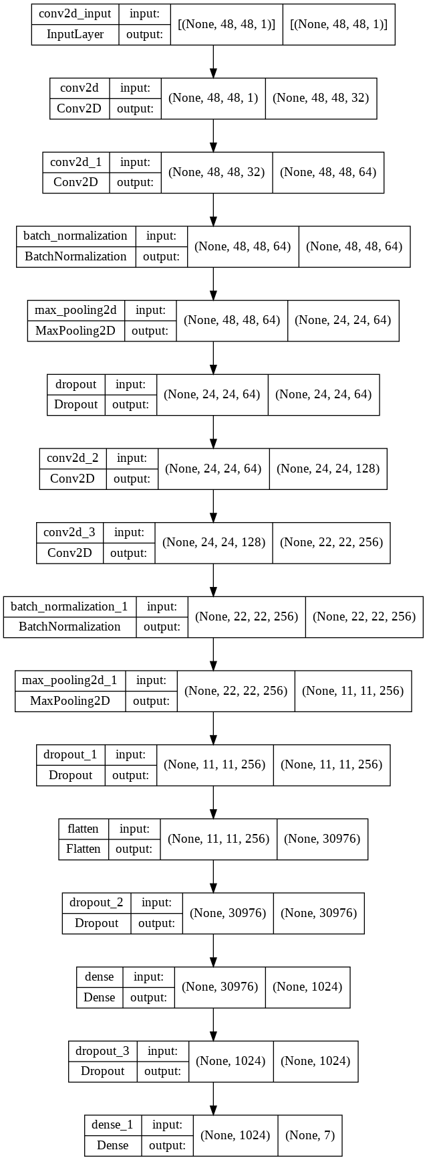
Methodology
Model Architecture:
Using Dropout, regularization,
BatchNormalization to avoid overfitting.

Slide 7
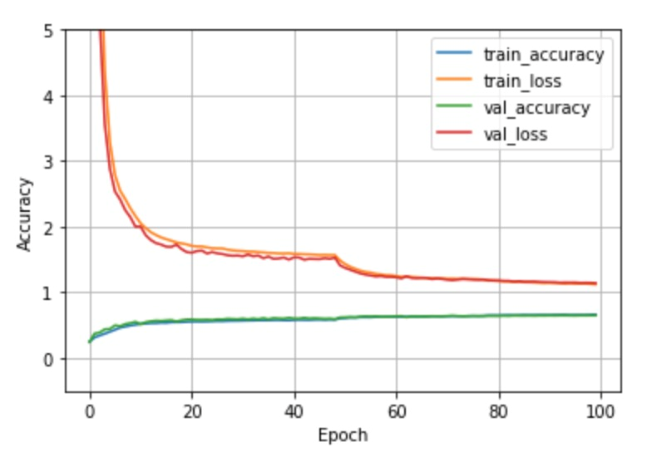
Results
Accuracy:
Final validation accuracy:
About 65.1%
Loss and accuracy curves

Slide 8
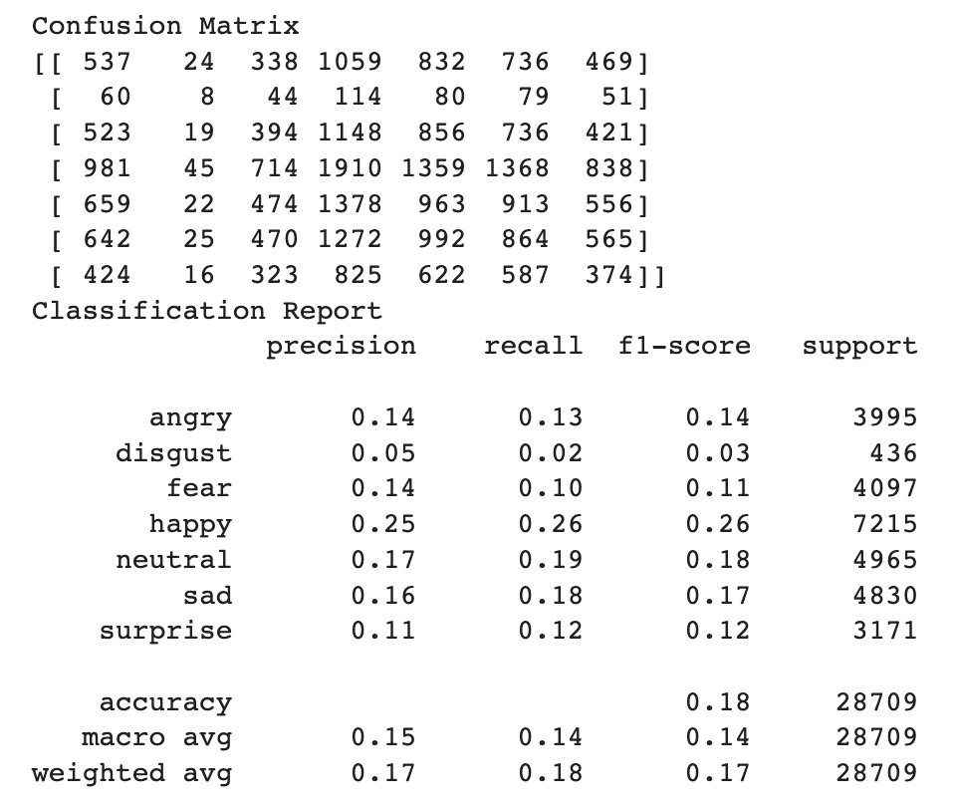
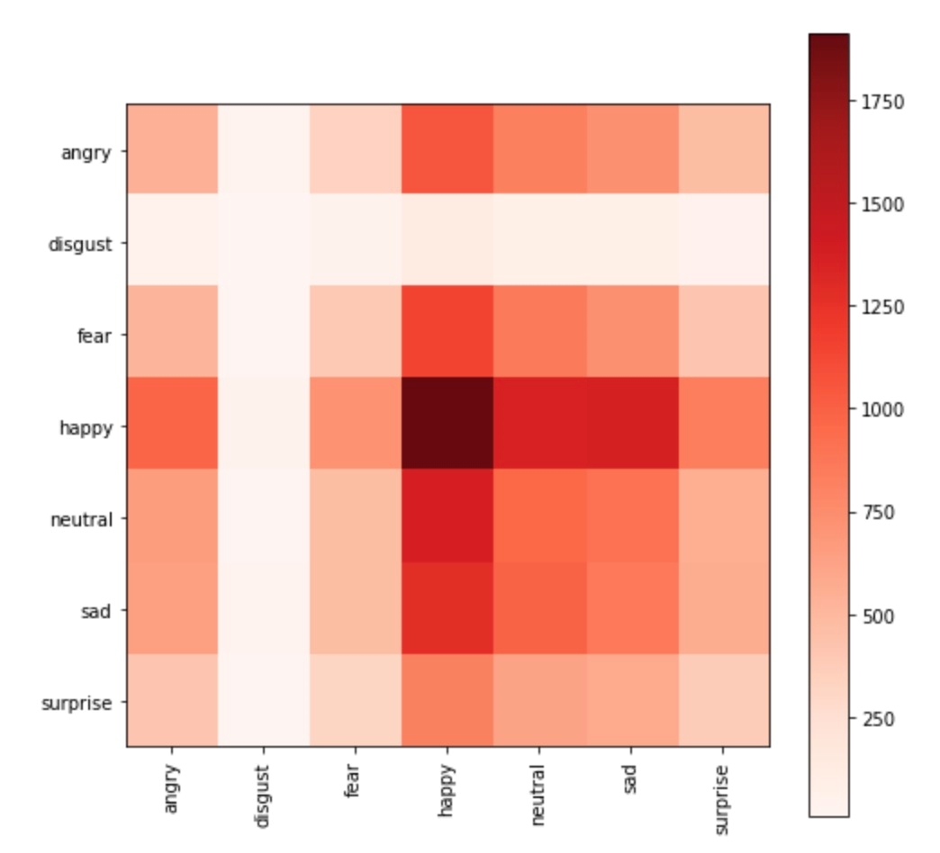
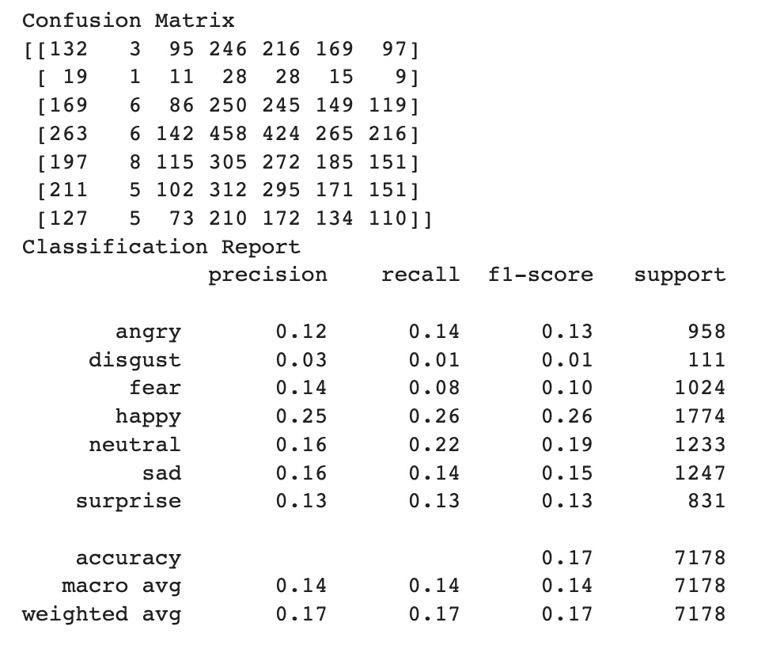
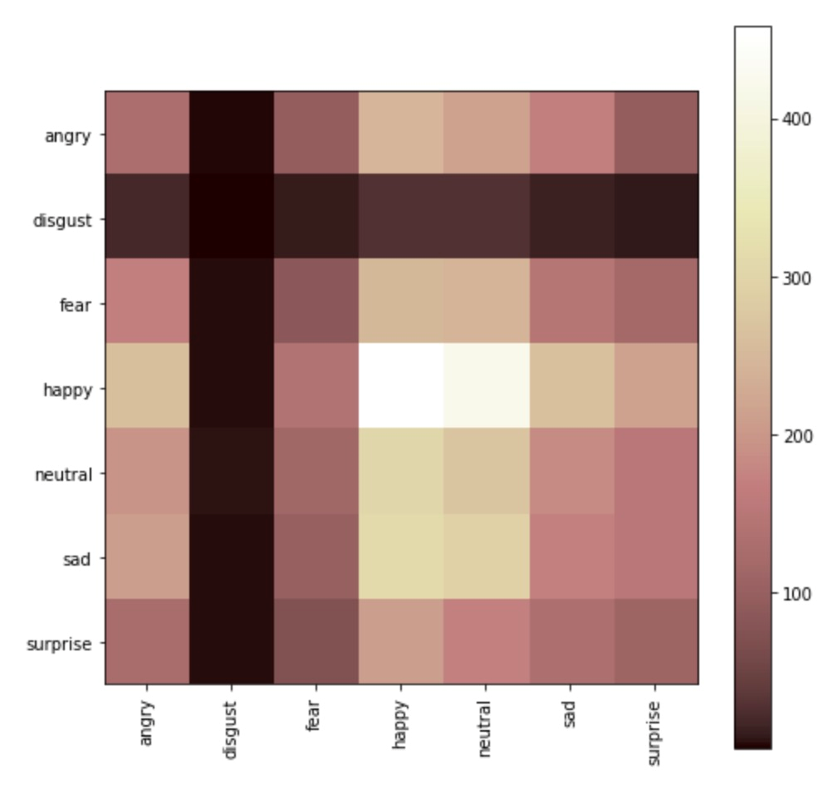
Results
Confusion Matrixs:
Training confusion matrix Testing confusion matrix
Maybe it is not always our fault hahaha.

Slide 9
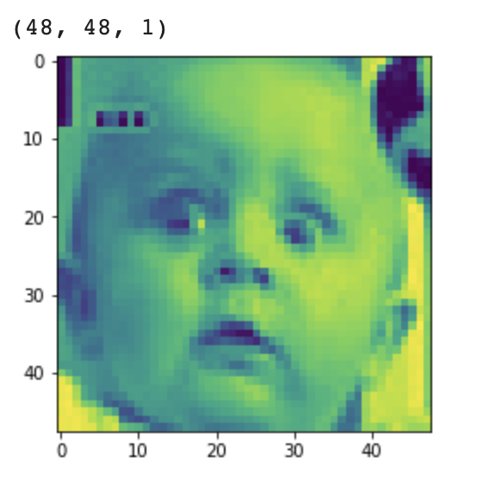
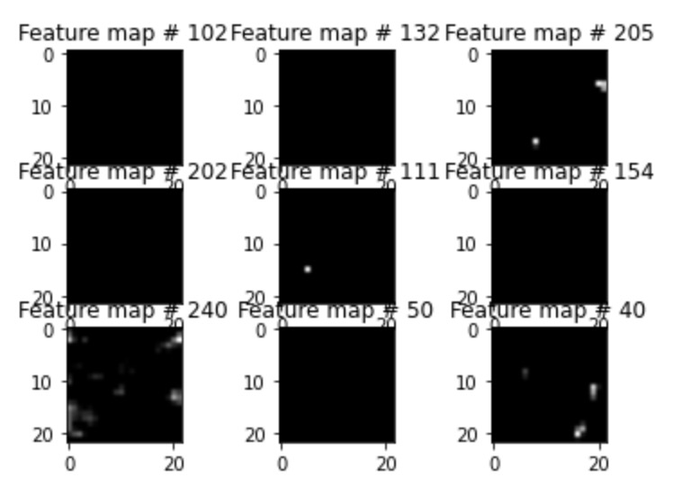
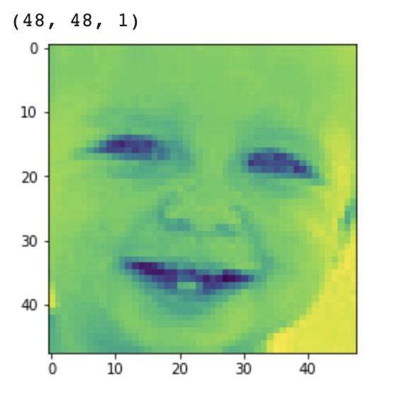
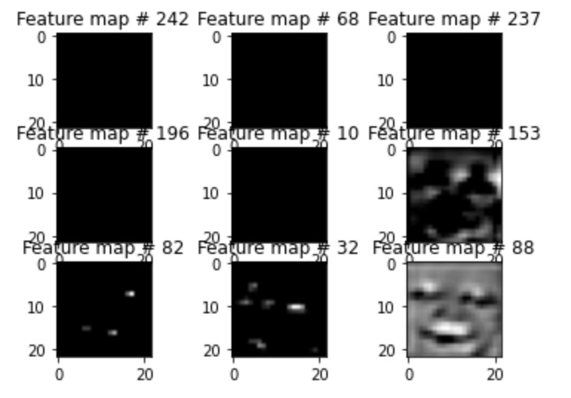
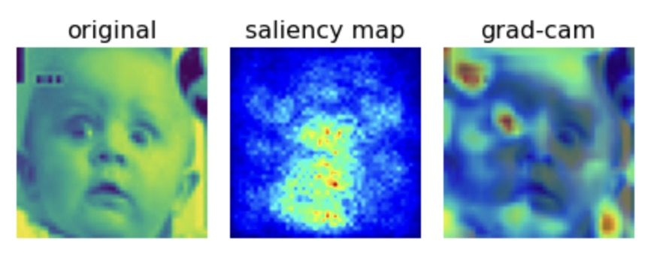
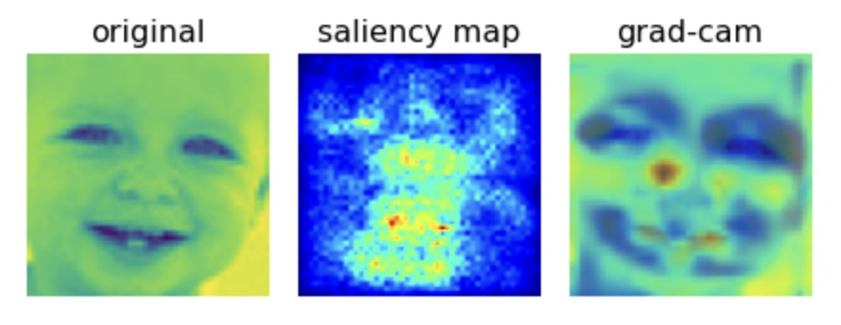
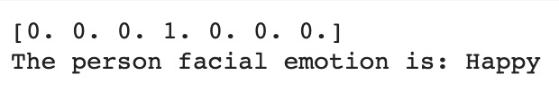
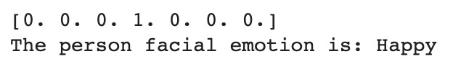



Predict
Two picture are randomly chosen to test this CNN network…
Surprise Happy

Slide 10
Conclusions
What we have learned:
Using data augmentation method to enlarge dataset for reinforcing model.
Using confusion matrix could help us examining the accuracy of results more intuitively.
Grad-cam shows that many of features in facial expression can influence the machine’s judgement. Thus it is a challenge to significantly improve the accuracy of the model.
Anything to improve:
Still need to modify the model to improve the accuracy.
Could use more methods or functions to visualize more information.

Slide 11
THANK YOU FOR WATCHING
Group 1

